Slide 1
Pupil PREMIUM STRATEGY Analysis
Outcomes of the 3 Year Strategy
2021- 2024

Slide 2
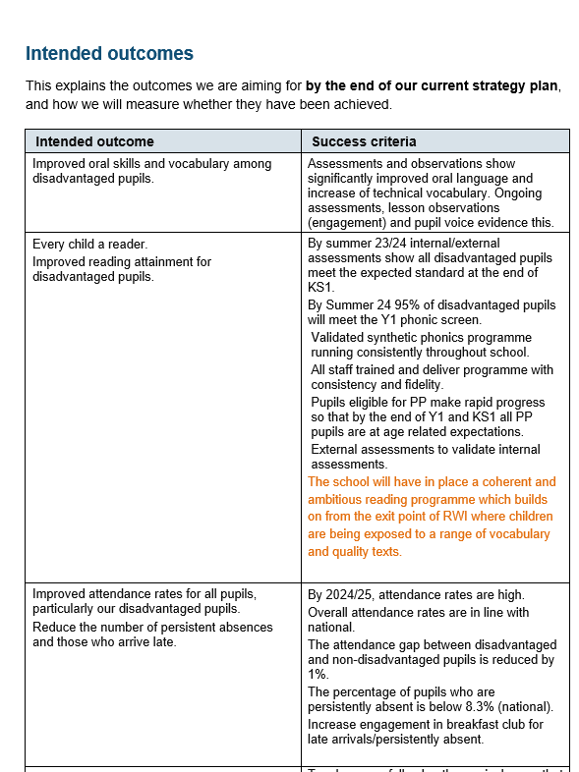
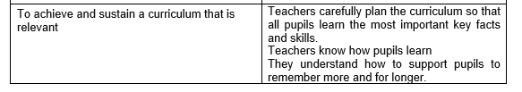
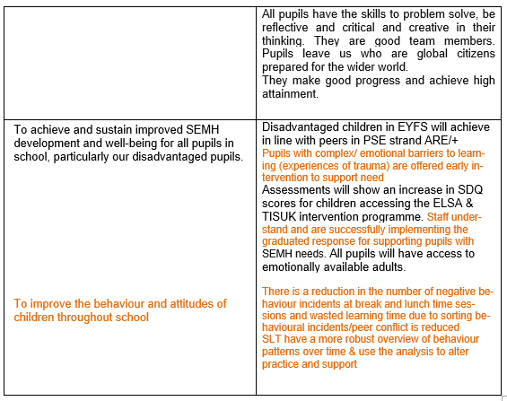

Slide 3

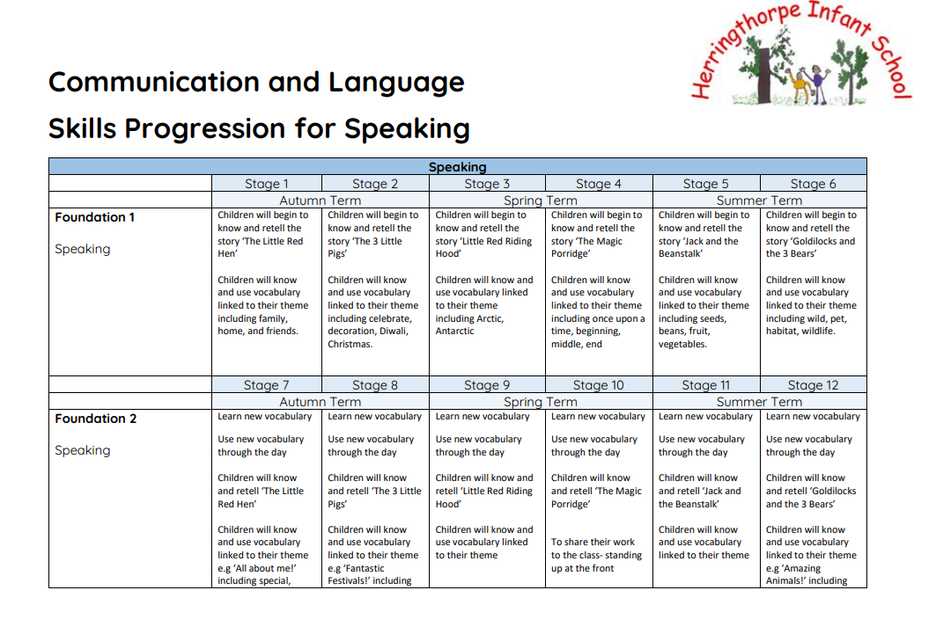
Improved oral skills and vocabulary among disadvantaged pupils.
 | 2022 | 2023 | 2024
EYFS outcomes for Speaking for PP cohort | 85% achieved exp | 94.4% achieved exp | 76.5% achieving exp

Slide 4
Every child a reader.
Improved reading attainment for disadvantaged pupils.
 | 2022 | 2023 | 2024
Year 1 Phonics Screen Outcomes for PP cohort | 47.4% passed | 85.2% passed | 81.8% (4/22 didn’t pass, all with SEND)
Year 2 Phonics Screen Outcomes for PP cohort | 33.3% passed | 76.9% passed | 50% (2/4 passed, other 2 SEND)
 | 2022 | 2023 | 2024
Year 2 Expected Reading Outcomes for PP cohort | 52.4% achieved exp | 63% achieved exp | 75.8% 7/29 not exs+ Out of these, 5 have SEND. Pure PP with no other needs = 93%
Year 2 GDS Reading Outcomes for PP cohort | 4.8% achieved GDS | 14.8% achieved GDS | 31%

Slide 5
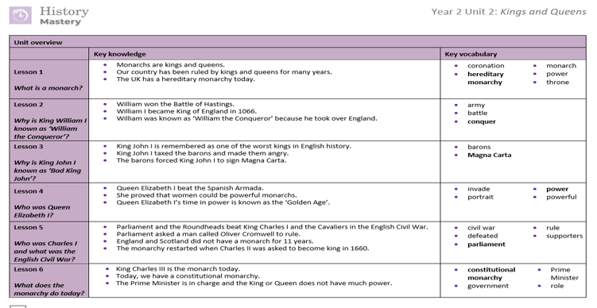
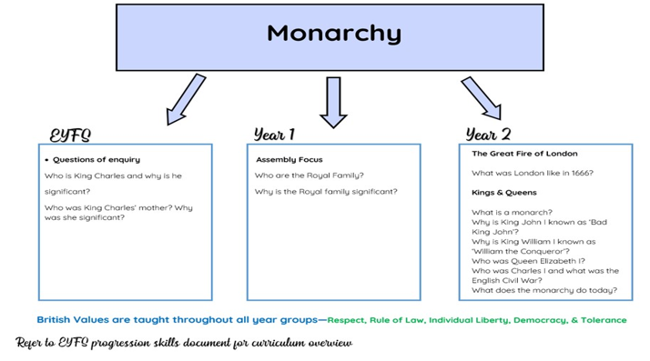
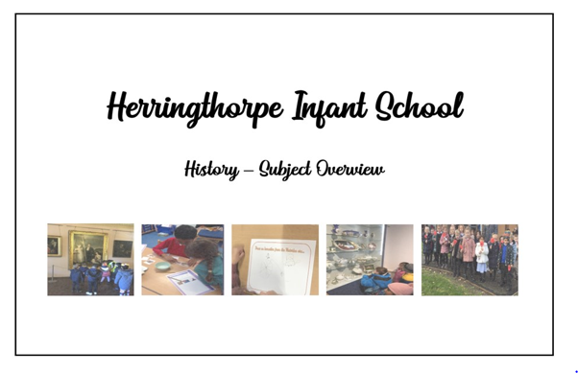
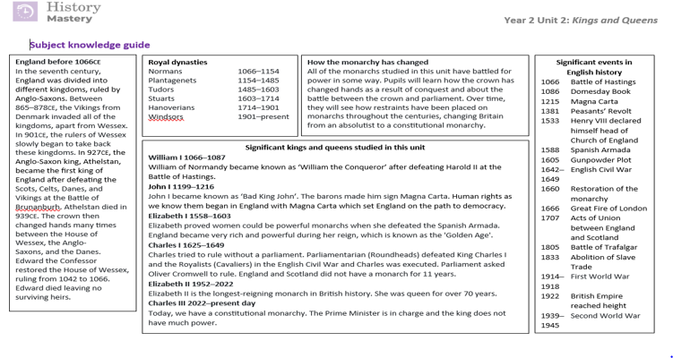

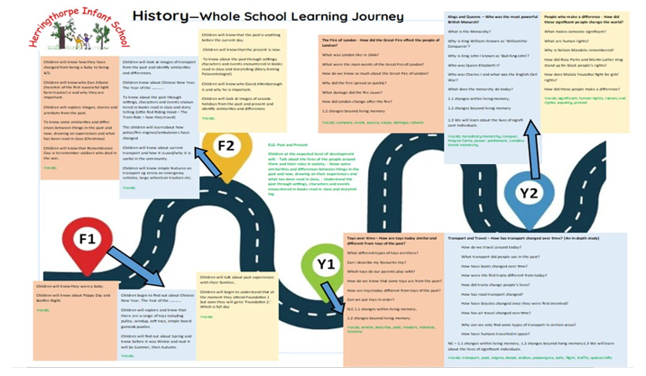
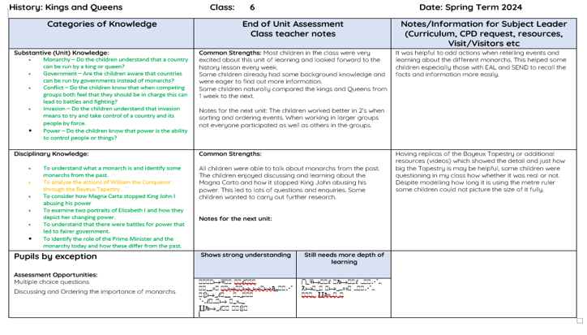
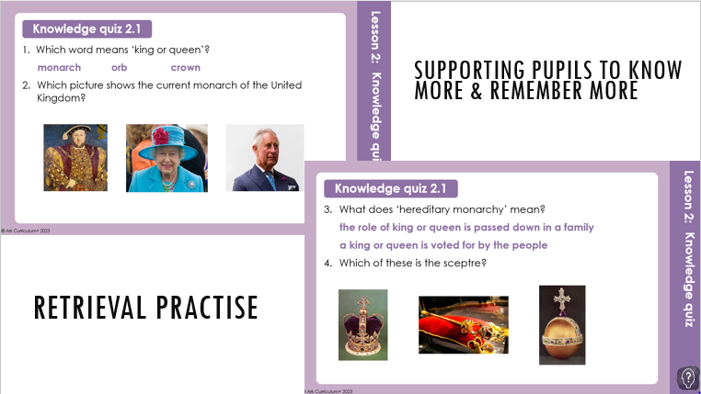
To achieve and sustain a curriculum that is relevant

Slide 6
Improved attendance rates for all pupils, particularly our disadvantaged pupils.
Reduce the number of persistent absences and those who arrive late.
 | 2021/2022 | 2022/2023 | 2023/to date
Attendance Outcomes for PP | 64.77% | 91.28% | 92.03%
Persistent Absence rates for PP | 97.30% | 35.06% | 29.4%

Slide 7
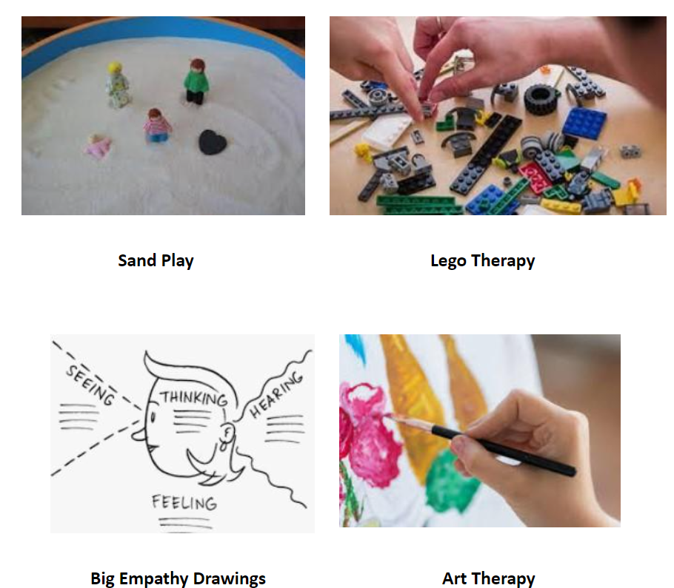


To achieve and sustain improved SEMH development and well-being for all pupils in school, particularly our disadvantaged pupils.

Slide 8
Summary of pupil premium data/Pupil premium strategy
Pupil Progress Data submitted and Gap analysis of Autumn Term & Spring Term demonstrated that school experienced:
Reading
41% Gap closure between PP pupils and non-PP pupils in Foundation 2
0.1% Gap closure between PP pupils and non-PP pupils in Year 1
1.4% Gap increase between PP pupils and non-PP pupils in Year 2
Writing
41% Gap closure between PP pupils and non-PP pupils in Foundation 2
5.1% Gap closure between PP pupils and non-PP pupils in writing in Year 1
5.1 Gap increase between PP pupils and non-PP pupils in Year 2
Maths
8.25% Gap closure between PP pupils and non-PP pupils in Foundation 2
5.5% Gap increase between PP pupils and non-PP pupils in year 1
1.7%Gap increase between PP pupils and non-PP pupils in Year 2

